Slide 1
Bluetooth Travel Sensors Austin, TX
Brandon Sams

Slide 2
Overview
Austin, TX has Bluetooth sensors all over the city
Tracks movement of Bluetooth devices
Able to infer which are most likely vehicles
Data is available from here in two formats:
API
.csv file
Traffic Match Summary Records will be the table of focus
Broken into 15 minute intervals
Filtered down to Bluetooth data from vehicles

Slide 3
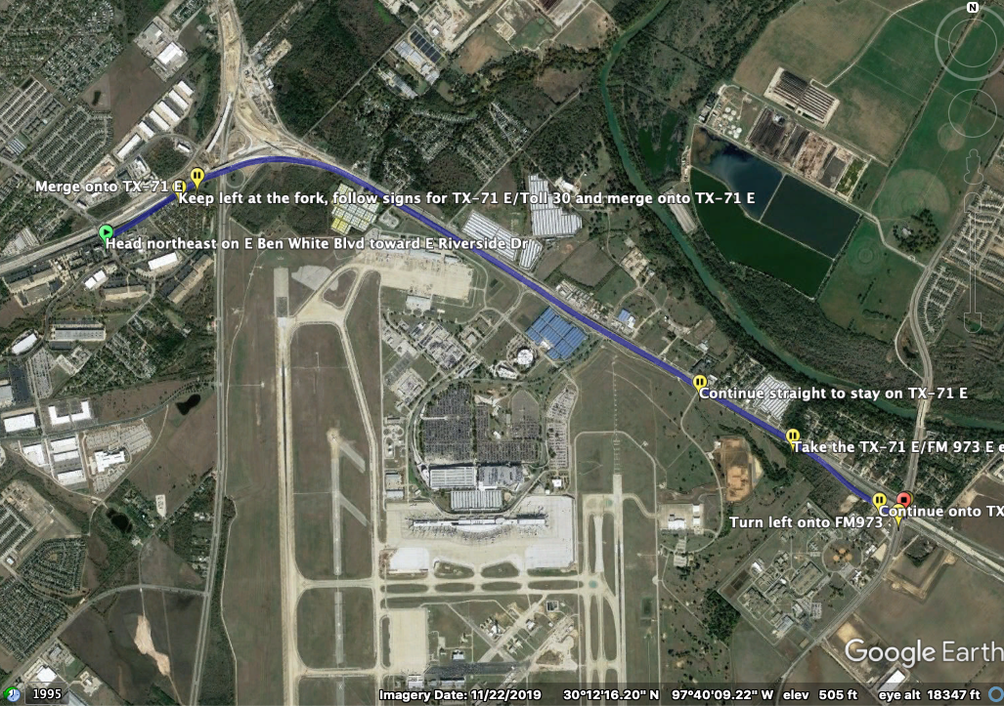
Pick a segment for analysis
Segment between Ben White/Riverside and Ben White/FM 973
Length: 3.63 Miles
Variations in Traffic Flow
Large volume of Traffic Flow
Main Road

Slide 4
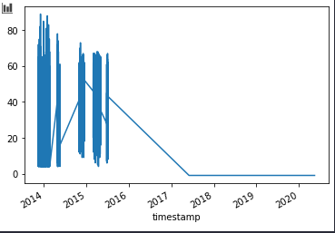
Choosing a Data Source: Plot Speed Records
From API Query:
From CSV file:

Slide 5
Large Gaps in Data
When plotting data such as speed, we see that this dataset has not been maintained for some time
Most recent data has a speed of -1, which appears to be the null value
There was a period from early 2014 where the data seems consistent
It is not clear if this lack of data is due to the filtering not being done on the data recently, or if the data is not being collected anymore

Slide 6
So what data do we have?
Ignoring the rows that are invalid, there are 14840 15-minute chunks that can be analyzed
Relevant Columns:
timestamp
average_travel_time_seconds
average_speed_mph
number_samples
standard_deviation
segment_length_miles

Slide 7
Adding new fields
Given the timestamp field, we can extract the following information:
Time of Day
Day of Week
I hypothesize that we will see much more predictable behavior on weekdays, and far more chaotic behavior on the weekends
We will need to find a way to compute means and standard deviations
This will be done for both travel time and speed, although I anticipate that this will be similar in both cases

Slide 8
Current challenges with computation
Each row currently tell me how many cars drove by in that 15-minute interval, and what their average speed and travel time is
Computing global averages for a given interval (say, 17:00-17:15) is proving to be challenging
Because averages are given already, we cannot just average the averages. That would not be weighted properly
Slicing by the day of the week also proving to be challenging
I may need to just make a new column called “isWeekday” containing a Boolean variable

Slide 9
Future Plans
Find a way to integrate R
The Exploratory Data Analysis and data cleaning has been done in python
R tends to be excellent for visualization
Once we can compare traffic flow at different times of the day one weekends to weekdays, I would like to run the same analysis on many other sections of road to see if they have similar behavior.

